Slide 1
Welcome teachers
to class 8C!

Slide 2
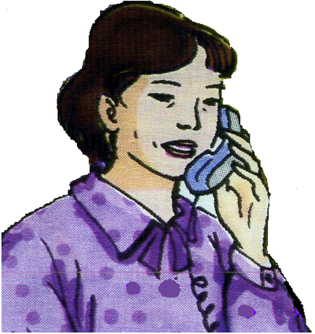
Mrs Quyen

Slide 3
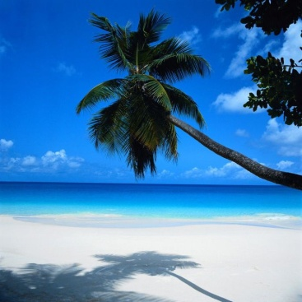
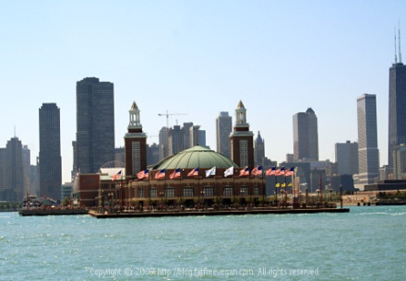
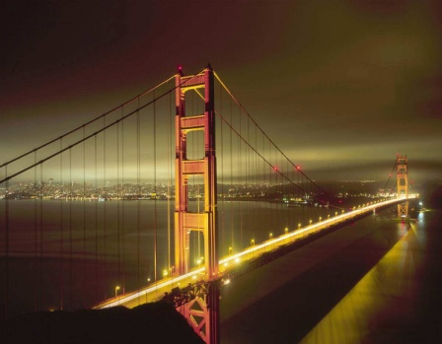
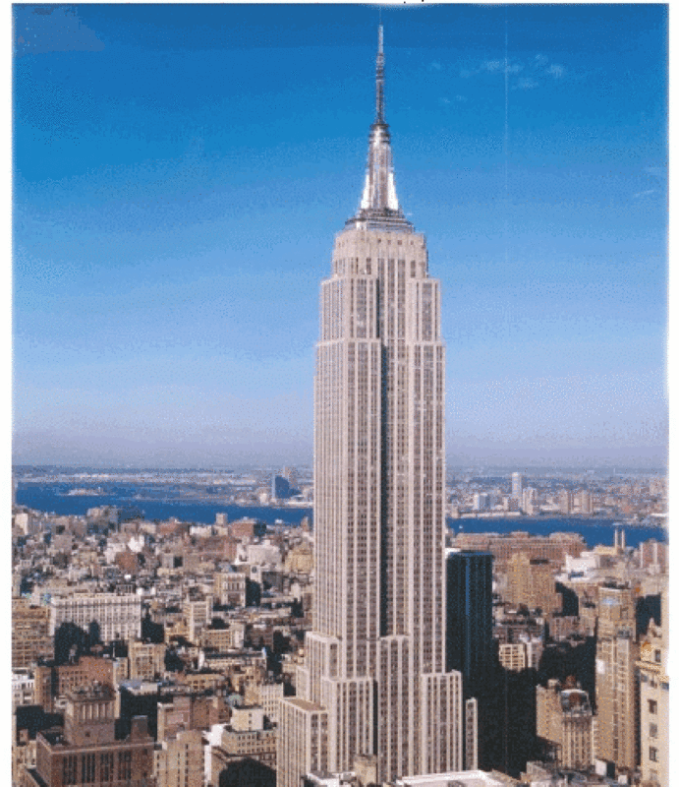
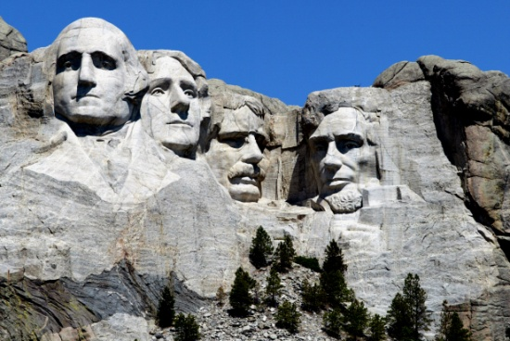
We went swimming at Waikiki Beach as soon as we arrived on the Hawaiian island of Oahu. We took a small plane to Kilauea Volcano this afternoon. The lava was pouring out when we flew overhead. It was very exciting.
Chicago is often called “The Windy City”. It’s situated right on the shore of Lake Michigan, one of the Great Lakes.
Today we went on an eight-hour tour which included Fisherman’s Wharf, the Napa Valley wine-growing area, and the famous prison on the island of Atcatraz in the middle of San Francisco Bay.
Yesterday while Dad was visiting the Statue of Liberty and the Empire State Building, I went shopping. I bought lots of souvenirs of our trip.
This is a picture of Mount Rushmore where the heads of four American presidents are carved into the rock. Mount Rushmore can be seen from more than 100 kilometers away.

Slide 4
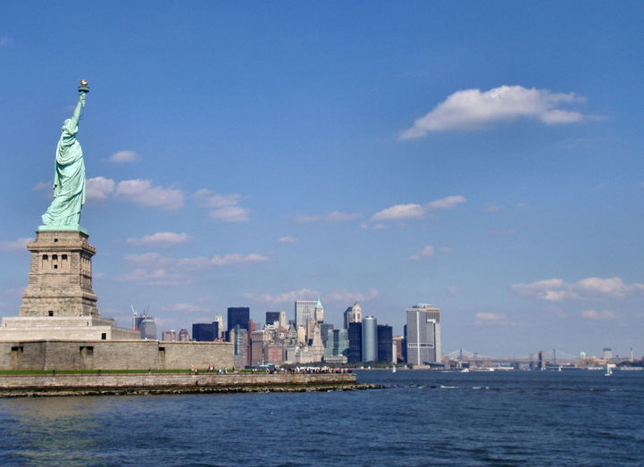
Unit 12: A vacation abroad.
Period 76: Lesson 4 - Write
The Statue of Liberty – New York– USA

Slide 5
Exercise 1: Complete the postcard Mrs Quyen sent from the USA.
Dear Sally,
We’re having a wonderful time ……(1)the USA. The …..…… (2) are friendly and the ………… (3) has been warm and sunny.
In San Francisco, I ………….. (4) my friend, Sandra Smith and ………(5) family. It was …………(6) to see them.
I ……......…. (7) lots of souvenirs ………. (8) the children.
Thanh is always complaining about the …….………….(9) of my suitcase.
See you …………(10)
Love,
Quyen
in
people
weather
visited
her
nice
bought
for
heaviness
soon

Slide 6
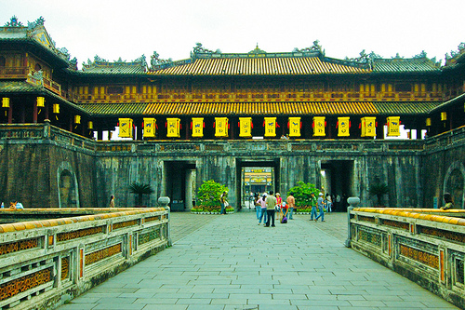
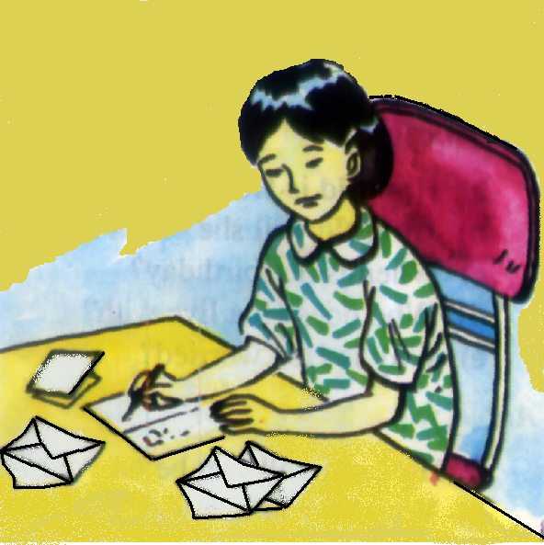
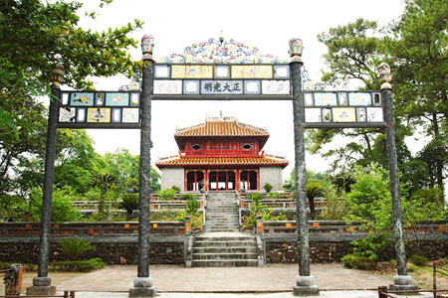
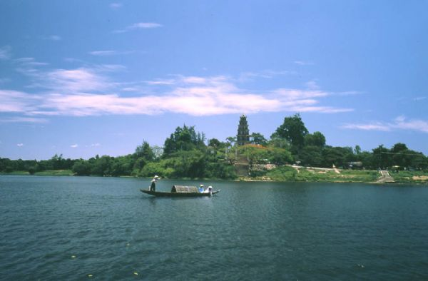
Mai
Hue city

Slide 7
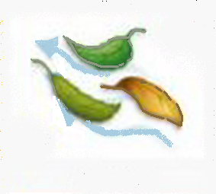
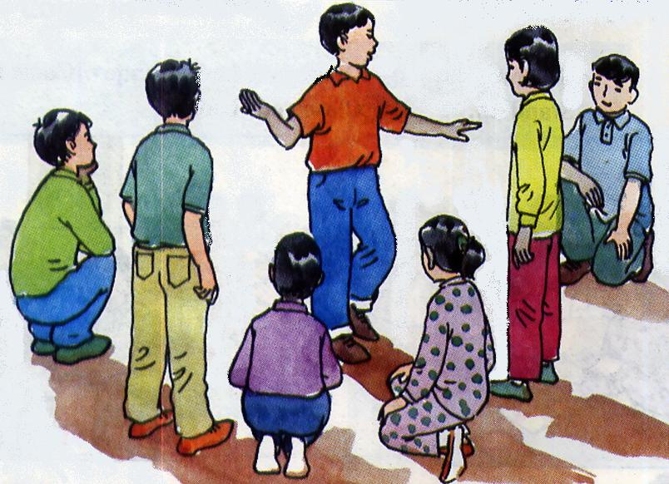
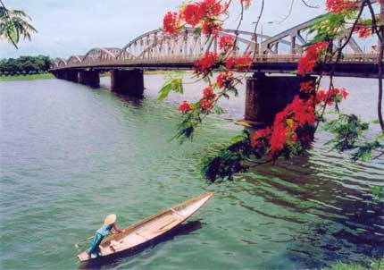
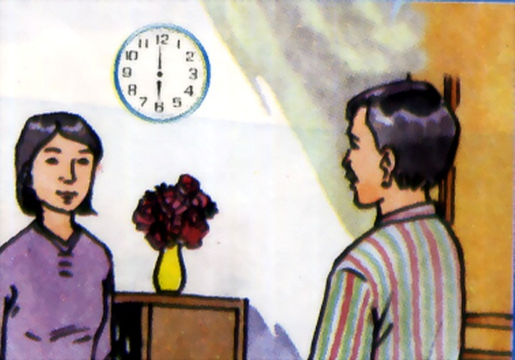
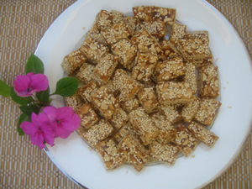
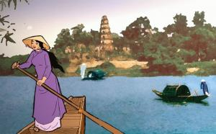
Sunny - windy
Hue city
people / sociable
Mai
visit / my uncle, Hung
see / Truong Tien Bridge
buy / traditional cakes
Tomorrow / visit / Huong river

Slide 8
Mrs Quyen’s postcard
Dear Sally, We are having wonderful time in the USA. The people are friendly and the weather has been warm and sunny. In San Francisco, I visited my friend. Sandra Smith and her family. It was nice to see them. I bought lots of souvenirs for my children. Thanh is always complaining about the heaviness of my suitcase. See you soon. Love, Quyen
Mai’s postcard
Dear Hoa, We are having wonderful time in Hue. The people are sociable and the weather has been windy and sunny. In Hue, I visited my uncle, Hung and his family. It was nice to see them. .It is very beautiful. I bought lots of traditional cakes for my friends. See you soon. Love, Mai
I also saw Truong Tien Bridge.
Tomorrow, we’re going
to visit Huong River.

